Slide 1
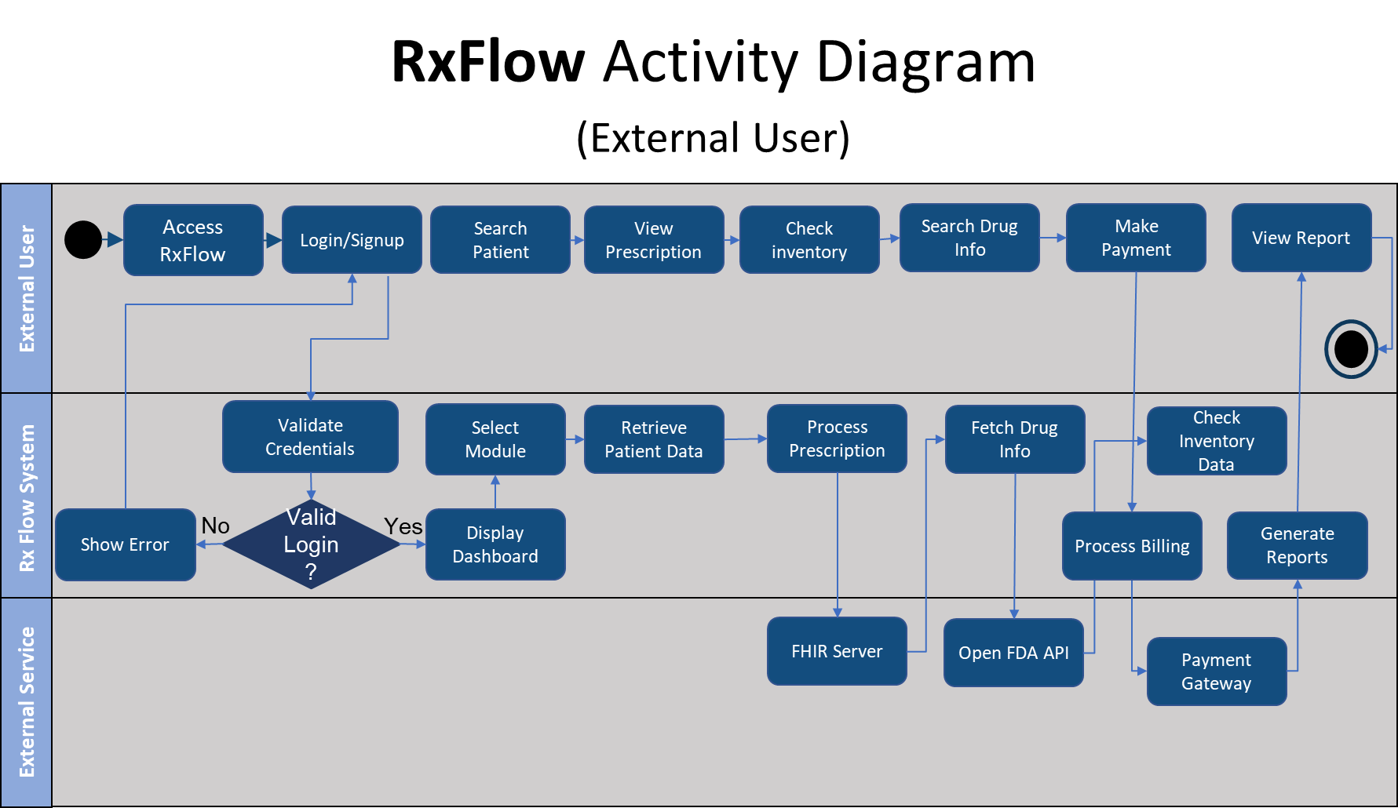

Slide 2
RxFlow Activity Diagram
(Internal Users)
Sales &
Marketing
Team
Identify pharmacy lead
Create sales opportunity
Present demo / proposal
Receive onboarding request
Create pharmacy profile
Provide onboarding support
Create staff account & permission
Confirm system readiness
Customer
Support
Management
Troubleshoot & reset profile data
No
Setup complete?
Yes
Create billing account
Assign subscription plan
Issue invoice / payment request
Activate billing and revenue tracking
Finance &
Billing
Team
Follow up on payment issue
Issue new invoice / payment request
Activate billing and revenue tracking

